Slide 1

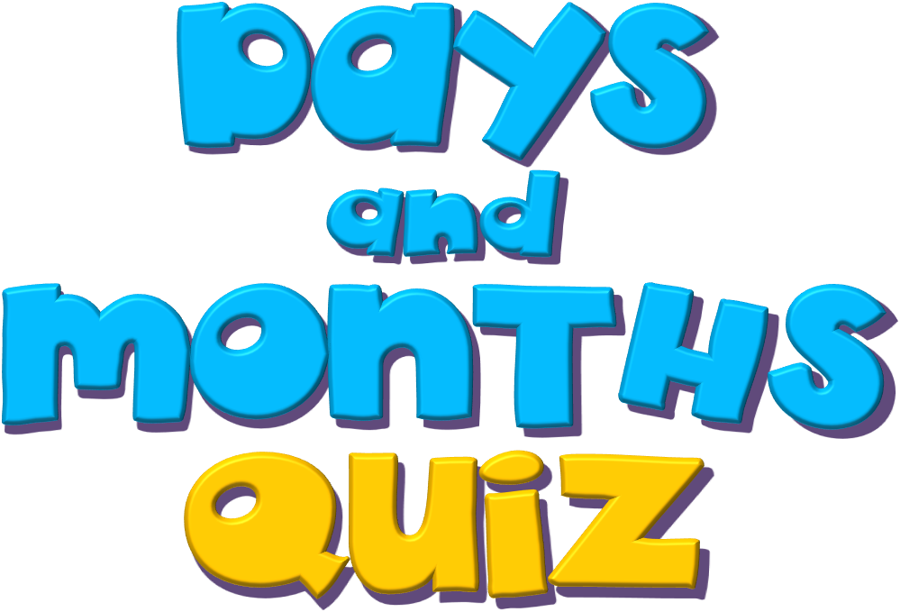
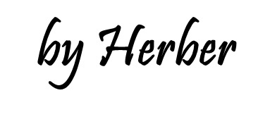

Slide 2

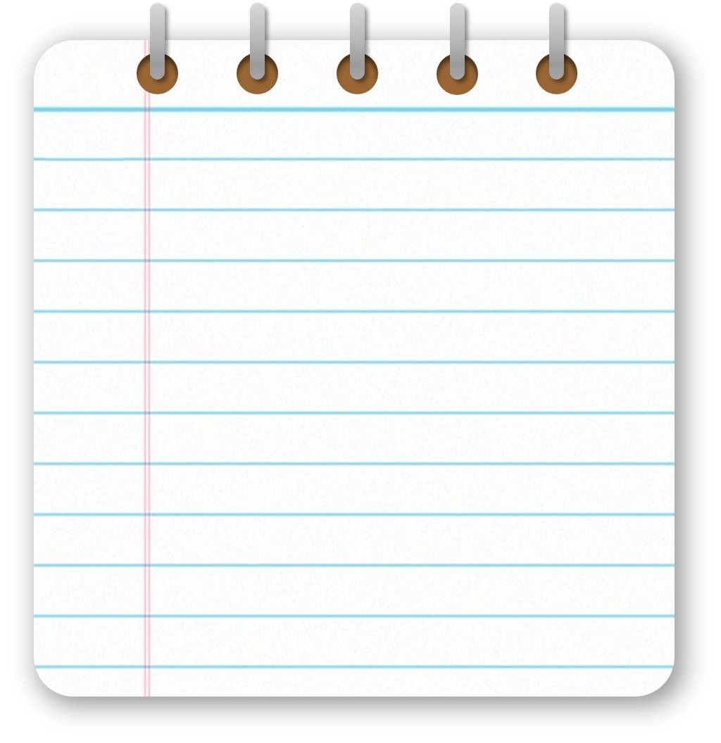



Days
of the
week

Slide 3

Monday
Friday
Tuesday
Saturday
Wednesday
Sunday
Thursday

Slide 4
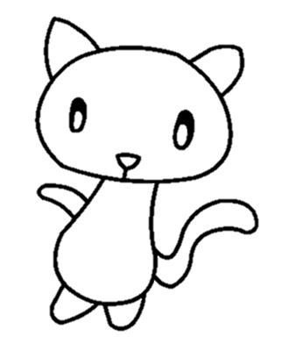
1/7
We don’t go to school this day.
Sunday
Monday
Sunday
Friday

Slide 5
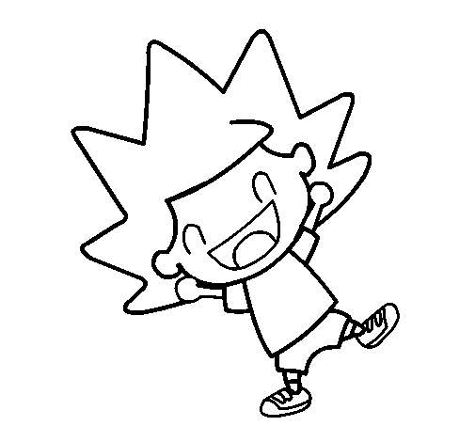
2/7
The day before Thursday.
Monday
Wednesday
Wednesday
Saturday

Slide 6
3/7
A shopping day called “Black … “
Thursday
Friday
Friday
Saturday

Slide 7
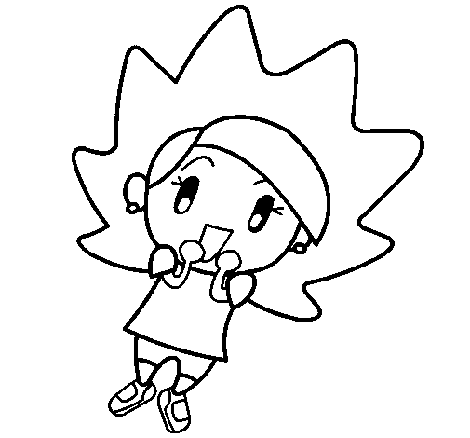
4/7
The day before Friday.
Thursday
Monday
Thursday
Friday

Slide 8
5/7
The day after Monday.
Tuesday
Wednesday
Tuesday
Friday

Slide 9
6/7
A day of the weekend.
Monday
Tuesday
Saturday
Saturday

Slide 10
7/7
The first day of the week.
Sunday
Tuesday
Monday
Monday

Slide 11
Months
of the
year

Slide 12
January
July
February
August
March
September
April
October
May
November
June
December

Slide 13

1/12
The first month of the year.
April
February
January
January

Slide 14

2/12
Halloween is in this month.
October
November
October
December

Slide 15

3/12
The month after July.
June
August
August
September

Slide 16

4/12
The month of Christmas.
December
November
December
January

Slide 17

5/12
There are a lot of flowers in this month.
March
May
May
June

Slide 18

6/12
The school year starts in this month.
June
February
September
September

Slide 19

7/12
Saint Valentine’s day is in this month.
June
April
February
February

Slide 20

8/12
Fools-day is in this month.
July
April
April
June

Slide 21

9/12
In America, the Independence Day is in this month.
July
June
July
January

Slide 22

10/12
Easter is in April or …
May
June
March
March

Slide 23
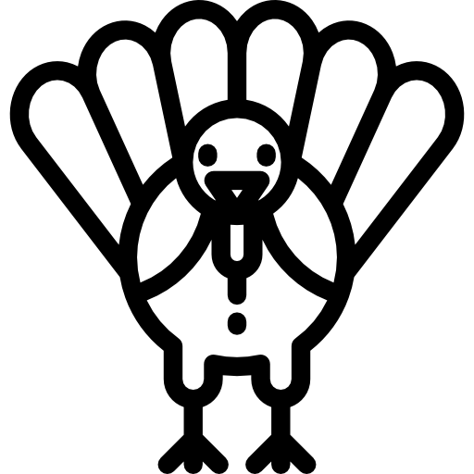
11/12
Thanksgiving Day is in this month.
September
November
November
December

Slide 24
12/12
The month before July.
April
May
June
June
EXIT

